Slide 1
Corrective Action Review for Calibration Meeting (May, 2014)
Team B:
Jim Carlisle, John Carlin and Rebeca Navarrete

Slide 2
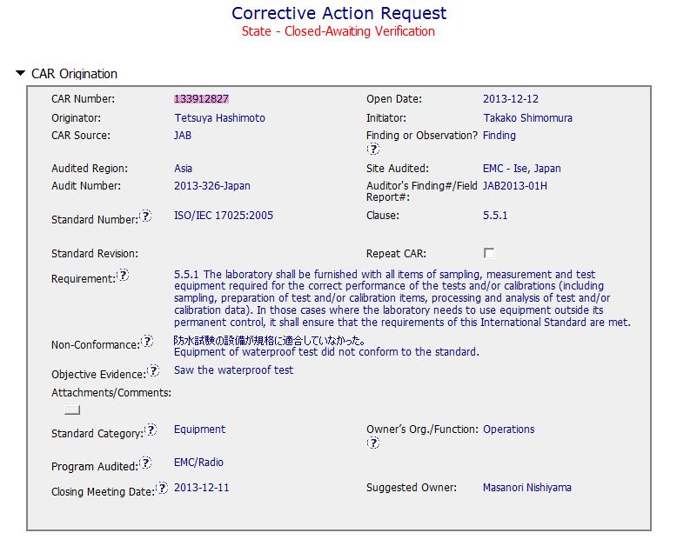
CAR 133912827 – JAB Audit Finding
Don’t provide enough evidence to readers.
Equipment ID and/or characteristics?
Project associated?

Slide 3
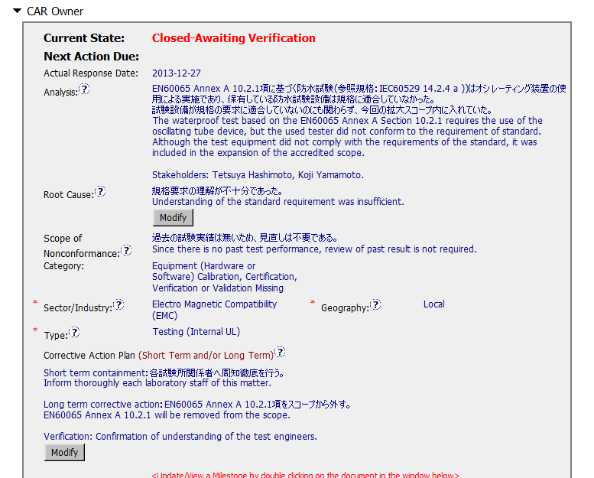
CAR 133912827 – JAB Audit Finding
Analysis is only restating the NC.
Why the NC escaped from detection?
Why the root cause was leaved as a misunderstanding of requirement when it is clear in the standard?
Part of Analysis
Containment should be to stop the bleeding. In this case, would be better to avoid to accept any job requiring this test.
Based on previous action, verification should be the scope reduction completed by AB & notification to all personnel involved
CA Plan only include to inform to Engineering, What about Sales, CSP, etc.?

Slide 4
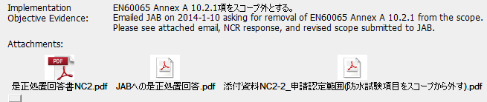
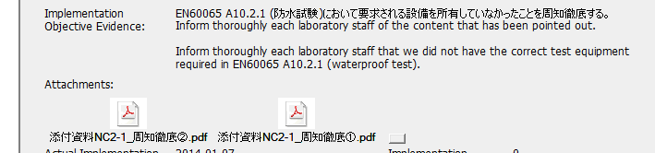
CAR 133912827 – JAB Audit Finding
Evidence provided in each milestone is in Japanese.
CAR Administrator added a short explanation in English of the content of each attachment to make it accessible to readers.

Slide 5
CAR 133912827 – JAB Audit Finding
INTEGRITY
(T) All responses and reviews were completed on time (Only the completion of the 1st milestone was provided the same day the CAR was overdue)
(T) CAR fields completed accurately. CAR Admin ensured to update each milestone to make it clear to any reader.
COMPETITIVENESS
(C) Analysis, root cause statement, milestone, containment and verification, are not in compliance with the requirements as noted previously.
(P) CAR State is Closed-Awaiting Verification but:
CAR Effectiveness indicator is blank
The last milestone shows that was requested to eliminate the test from the scope, Why is the CAR Awaiting Verification when no further actions nor new samples can be evaluated? (Are waiting for Scope reduction evidence from AB?)

Slide 6
CAR 133912827 – JAB Audit Finding
COLLABORATION
(L) Communication of CAR Administrator with CAR Owner to guide through the process is evident in some parts of the CAR History.
(C L) No evidence of communication when CAR was overdue

